Slide 1
FORMAT MODELS
DATE AND NUMBER

Slide 2
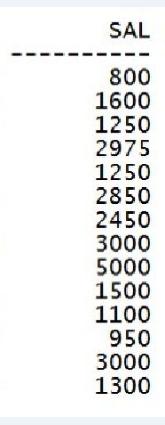
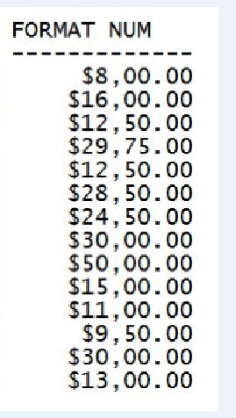
EXAMPLE

Slide 3
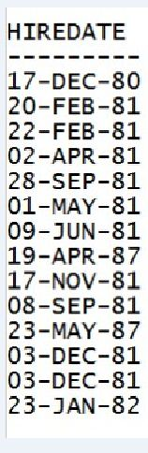
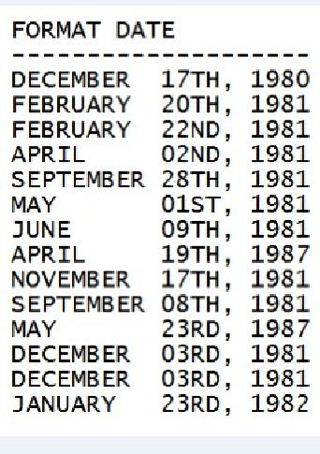
EXAMPLE

Slide 4
FORMAT MODELS
A format model is a character literal that describes the format of datetime or numeric data stored in a character string.
A format model does not change the internal representation of the value in the database.

Slide 5
Data type conversion
Implicit data type conversion
Explicit data type conversion
Notes:
Oracle Database 11g: SQL Fundamentals I 4 - <number>

Slide 6
IMPLICIT DATA TYPE CONVERSION
From
To
VARCHAR2 or CHAR
NUMBER
VARCHAR2 or CHAR
DATE
From
To
NUMBER
VARCHAR2 or CHAR
DATE
VARCHAR2 or CHAR
Notes:
Oracle Database 11g: SQL Fundamentals I 4 - <number>
Implicit Data Type Conversion
Oracle server can automatically perform data type conversion in an expression. For example, the expression hire_date > '01-JAN-90' results in the implicit conversion from the string '01-JAN-90' to a date. Therefore, a VARCHAR2 or CHAR value can be implicitly converted to a number or date data type in an expression.

Slide 7
EXPLICIT DATA TYPE CONVERSION
TO_NUMBER
TO_DATE
NUMBER
CHARACTER
DATE
TO_CHAR
TO_CHAR
Notes:
Oracle Database 11g: SQL Fundamentals I 4 - <number>
Explicit Data Type Conversion
SQL provides three functions to convert a value from one data type to another:

Slide 8
TO_CHAR WITH DATETIME
TO_CHAR(
{ datetime }
[, 'fmt' [, 'nlsparam' ] ]
)
Notes:
Oracle Database 11g: SQL Fundamentals I 4 - <number>
Explicit Data Type Conversion
SQL provides three functions to convert a value from one data type to another:

Slide 9
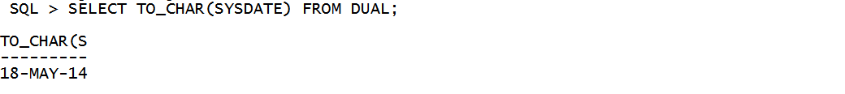
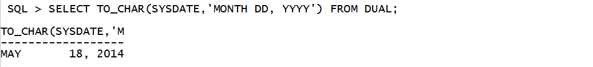
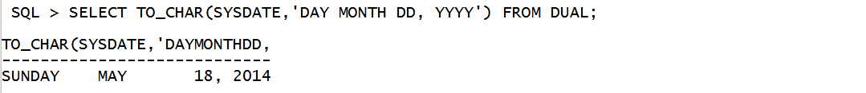
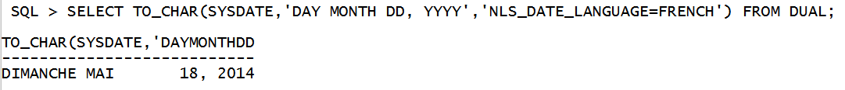
TO_CHAR EXAMPLES

Slide 10
DATETIME FORMAT ELEMENTS
AD or BC : AD or BC indicator
A.D. or B.C. : AD or BC indicator with periods
AM or PM : Meridian indicator
A.M. or P.M. : Meridian indicator with periods

Slide 11
DATETIME FORMAT ELEMENTS
D : Day of week (1-7)
DY : Day of week abbreviated. (Sun, Mon)
DAY : Name of day, padded with blanks to length of 9 characters. (Sunday, Monday)
DD : Day of month (1 - 31)

Slide 12
DATETIME FORMAT ELEMENTS
DDD : Day of year (1 - 366)
J : Julian day (days since 4712 BC)
W : Week of the month (1 - 5)
WW : Week of year ( 1 - 53 )
MM : Two-digit month (01 - 12)

Slide 13
DATETIME FORMAT ELEMENTS
MON : Month name abbreviated (Jan, Feb)
MONTH : Name of month, padded with blanks to length of 9 characters (January , July)
RM : Roman numeral month ( I - XII )
Q : Quarter of year (1 - 4 : Jan-Mar = 1)

Slide 14
DATETIME FORMAT ELEMENTS
YYYY : Four-digit year (2000, 2004)
YYY,YY,Y : Last 3, 2, or 1 digits of year
YEAR : Year spelled out (Two thousand four)
Ex: 2014 : -> “TWENTY FOURTEEN”
SYYYY : If BC, year is shown as negative ( -1250)

Slide 15
DATETIME FORMAT ELEMENTS
DL : Day, Month dd, yyyy
DS : MM/DD/YYYY
IW : Week of year ( 1 - 53 )

Slide 16
RR DATE FORMAT
If Last two-digit of the specified year is:
0–49
50–99
If Last two digits of the current
year are:
The return date is in the current century
The return date is in the century before the current one
0–49
The return date is in the century after the current one
The return date is in the current century
50–99
Notes:
Oracle Database 11g: SQL Fundamentals I 3 - <number>
RR Date Format
The RR date format is similar to the YY element, but you can use it to specify different centuries. Use the RR date format element instead of YY so that the century of the return value varies according to the specified two-digit year and the last two digits of the current year. The table in the slide summarizes the behavior of the RR element.

Slide 17
RR DATE FORMAT EXAMPLE
Current Year
Specified Date
RR Format
YY Format
1995
1995
2014
2014
27-OCT-95
27-OCT-17
27-OCT-17
27-OCT-95
1995
2017
2017
1995
1995
1917
2017
2095
Notes:
Oracle Database 11g: SQL Fundamentals I 3 - <number>
RR Date Format
The RR date format is similar to the YY element, but you can use it to specify different centuries. Use the RR date format element instead of YY so that the century of the return value varies according to the specified two-digit year and the last two digits of the current year. The table in the slide summarizes the behavior of the RR element.

Slide 18
DATETIME FORMAT ELEMENTS
HH,HH12 : Hour of day (1 - 12)
HH24 : Hour of day ( 0 - 23 )
MI : Minutes of the hour ( 0 -59 )
SS : Seconds of the minute ( 0 - 59 )
SSSSS : Seconds of the day ( 0 - 86399 )
FF : Fractional seconds

Slide 19
DATETIME FORMAT ELEMENTS
TZR : Time zone region ( e.g . US/Central ,+05:30 )
TZH : Time zone hour ( e.g. 05 )
TZM : Time zone minute ( e.g. 30 )

Slide 20
DATETIME FORMAT ELEMENTS
/ , . ; : : Punctuation displayed as it is ,
e.g. ‘Y,YYY’ -> 2,004
“text” : Quoted text displayed as it is,
e.g. ‘DD “day of” Mon’ -> 5 day of May

Slide 21
DATETIME FORMAT ELEMENTS
TH : Ordinal Number ,e.g. ‘DDTH’ -> 4TH
SP : Spelled-out number, e.g. ‘DDSP’ -> FOUR
SPTH or THSP : Spelled-out ordinal numbers
e.g. ‘DDSPTH’ -> FOURTH

Slide 22
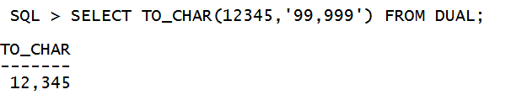
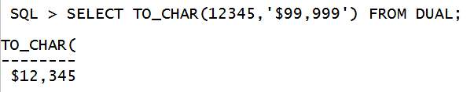
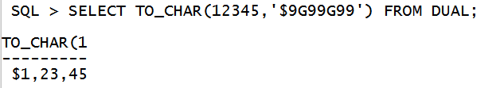
NUMBER FORMAT MODELS

Slide 23
TO_CHAR WITH NUMBER
TO_CHAR(
{ number }
[, 'fmt' [, 'nlsparam' ] ]
)
Notes:
Oracle Database 11g: SQL Fundamentals I 4 - <number>
Explicit Data Type Conversion
SQL provides three functions to convert a value from one data type to another:

Slide 24
NUMBER FORMAT MODELS
999 Returns value with the specified number of digits with a leading space if positive or with a leading minus if negative.
123.55 '999.99’ 123.55
-123.55 ‘999.9’ -123.6
0 Returns leading/trailing zeros.
11 '099.0’ 011.0
0 '00.0’ 00.0

Slide 25
NUMBER FORMAT MODELS
, (comma) Returns a comma in the specified position.
You can specify multiple commas in a number format model.
A comma cannot appear to the right of a decimal character or in the beginning of a number format model.
1123.55 '9,999.99’ 1,123.55
. (period) Returns a decimal point, which is a period (.) in the specified position. Only one period is allowed in a number format model.
1123.55 '9999.99’ 1123.55

Slide 26
NUMBER FORMAT MODELS
D Returns the decimal character in the specified position.
11.08 '99D99’ 11.08
G Returns the group separator in the specified position .
1115.08 '9G999’ 1,115
1115.08 '9G999D09' 1,115.08
$ Returns value with a leading dollar sign.
1123.55 '$9,999.99' $1,123.55

Slide 27
NUMBER FORMAT MODELS
L Returns in the specified position the local currency symbol (NLS_CURRENCY parameter).
123.45 'L999.99’ $123.45
FM Returns a value with no leading or trailing blanks.
12.45 'FM99.99’ ‘12.45’
12.45 '99.99’ ‘ 12.45’
EEEE Returns a value using in scientific notation.
123.45 '9.9EEEE’ 1.2E+02
123.45 '9.99EEEE’ 1.23E+02

Slide 28
NUMBER FORMAT MODELS
MI Returns negative value with a trailing minus sign (-) and positive value with a trailing blank. (appended at end)
-123 '999MI’ 123-
123 '999MI’ 123
PR Returns negative value in <angle brackets> and positive value with a leading and trailing blank.
-123 '999PR’ <123>
123 '999PR’ 123

Slide 29
NUMBER FORMAT MODELS
RN or rn Returns a value as Roman numerals in uppercase or lower case.
15 'RN’ XV
30 'rn’ xxx
X Returns the hexadecimal value of the specified number of digits. If the specified number is not an integer, Oracle rounds it to an integer.
15 ‘X’ F
26.6 'XX’ 1B

Slide 30
NUMBER FORMAT MODELS
S Returns negative value with a leading/trailing minus sign (-).
-123 'S999’ -123 -123 '999S' 123-
V Returns a value multiplied by 10^n (if necessary, rounds it up), where n is the number of 9’s after V
15 ’99v99’ 1500

Slide 31
Tuesday 2 nd day of the week 22nd May Two Thousand Four, 3 week of month

